Slide 1

Multimedia Programming 210
Week 2

Slide 2
Homework

Slide 3
SLACK

Slide 4
Review
<html>...</html> …....Start and end HTML
<head>...</head>…....Head of page, not actual content
<title>...</title> …......Title of page
<body>...</body>…....Body of page, where the content goes
<div>...</div> ….........Content section - Block level
<span>...</span> …...Grouping - Inline
<p>...</p> …..............Paragraph
<b>...</b>…...............Bold
<br />…......................Line break (you'll notice that this tag doesn't have any content and therefore is both an begin and end tag, with the slash)
<H1></H1>…............ (Also H2, H3, H4, etc..)
<!-- ... --> …...............Comments
<blink>...</blink> …..Make your text blink
<a href="http://...">...</a> Link to another page. The "href=""" portion is an attribute. Many tags have optional attributes.

Slide 5
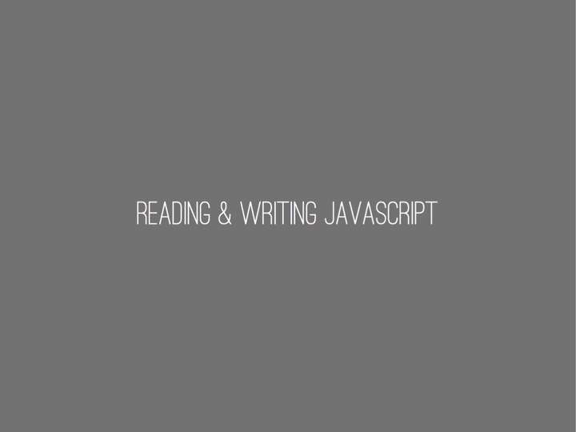

Slide 6
Hours Example

Slide 7
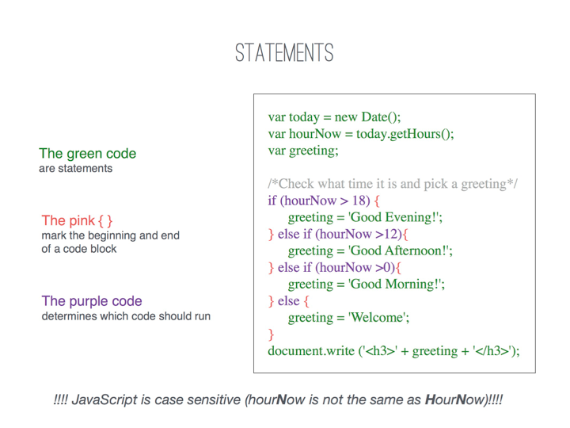

Slide 8
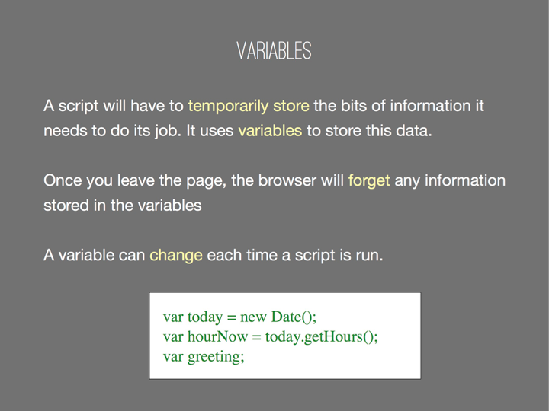

Slide 9
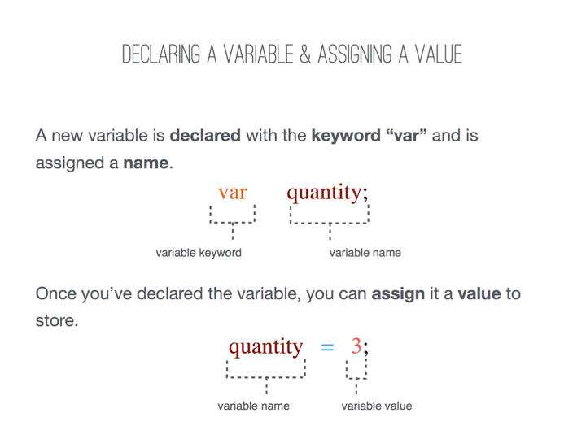
Notes:
var numPeople, $mainHeader, _num, _Num;
Not OK:
var 2coolForSchool, soHappy!

Slide 10
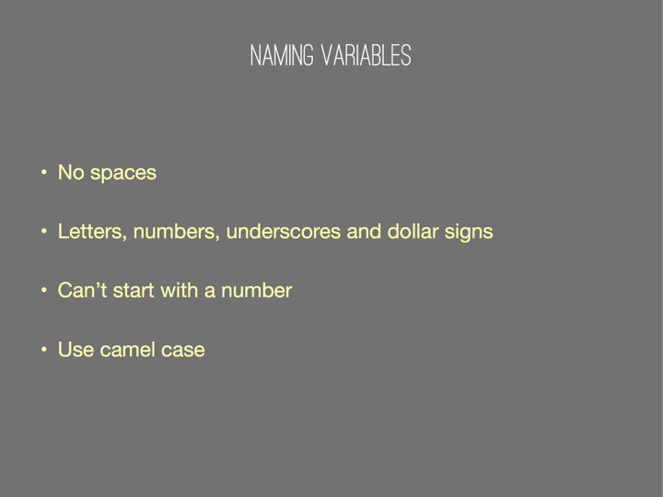
Notes:
var numPeople, $mainHeader, _num, _Num;
Not OK:
var 2coolForSchool, soHappy!

Slide 11
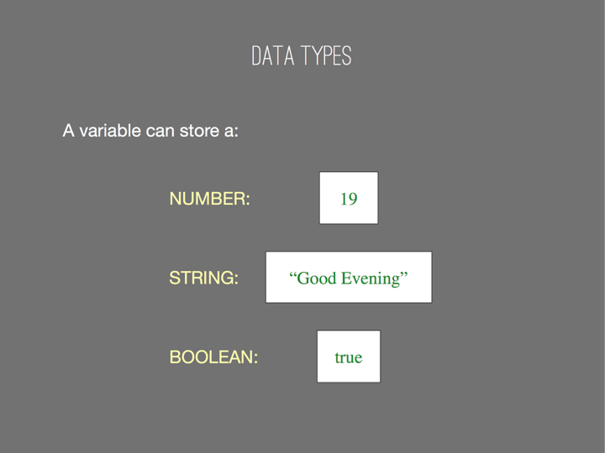

Slide 12
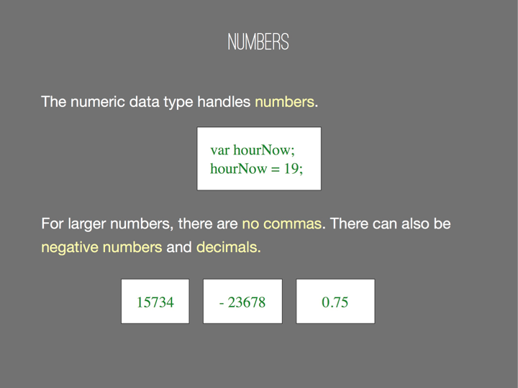

Slide 13
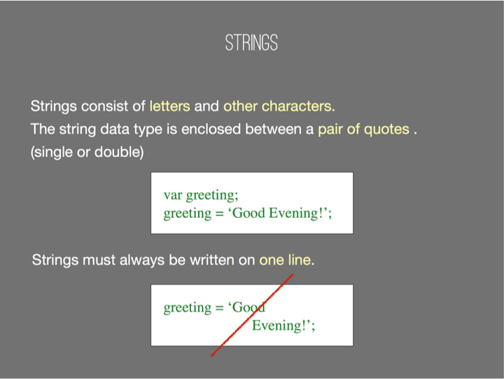

Slide 14
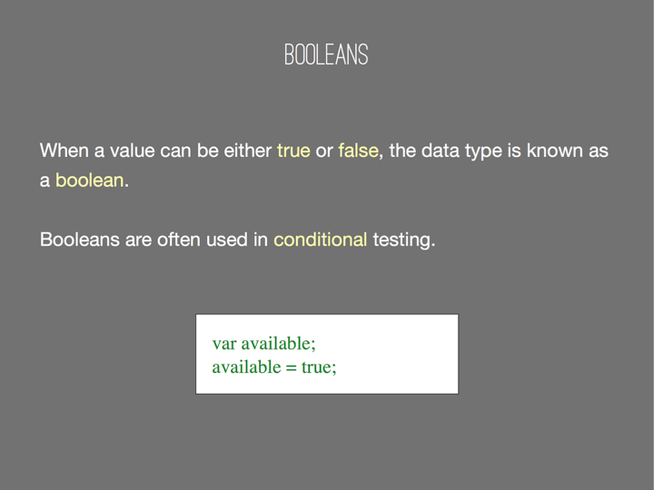

Slide 15
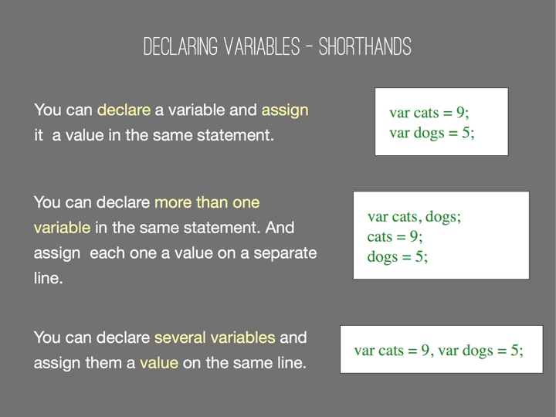

Slide 16
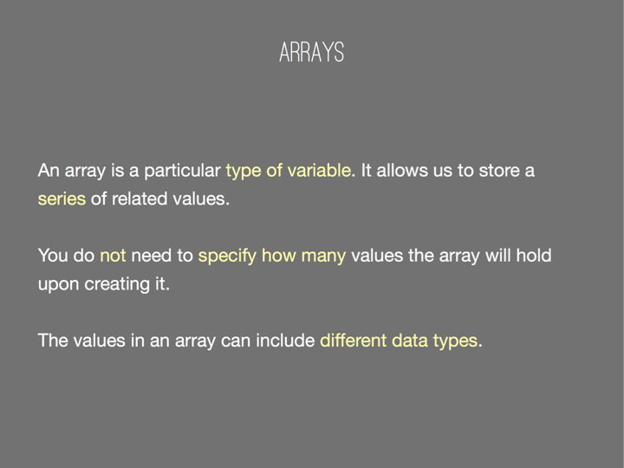

Slide 17
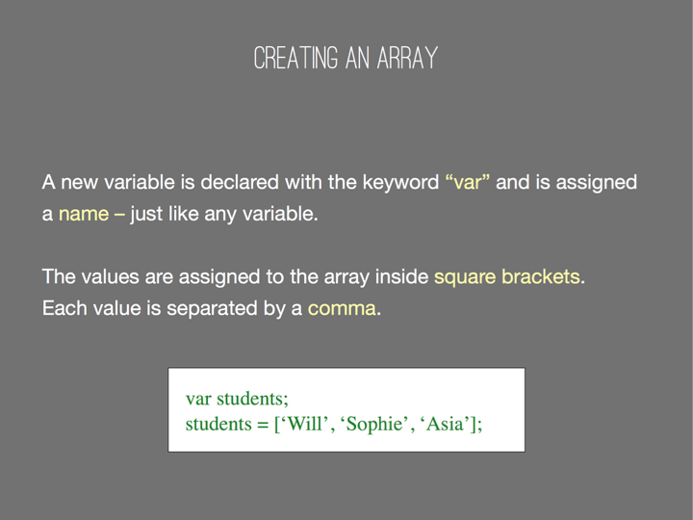

Slide 18
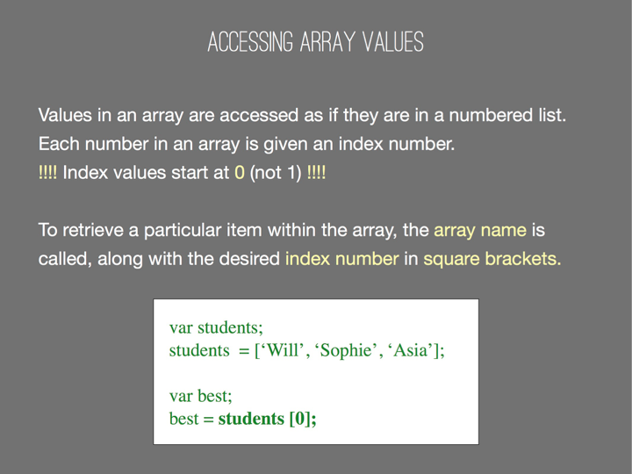
Notes:
Variables can also store the result of any "expression":
var x = 2 + 2;
var y = x * 3;
var name = 'Claire';
var greeting = 'Hello ' + name;
var title = 'Baroness';
var formalGreeting = greeting + ', ' + title;
var numKids = 5;
var partner = 'David Beckham';
var location = 'Costa Rica';
var jobTitle = 'web developer';
var future = 'You will be a ' + jobTitle + ' in ' + location + ', and married to ' +
partner + ' ' + ' with ' + numKids + ' kids.';
console.log(future);

Slide 19
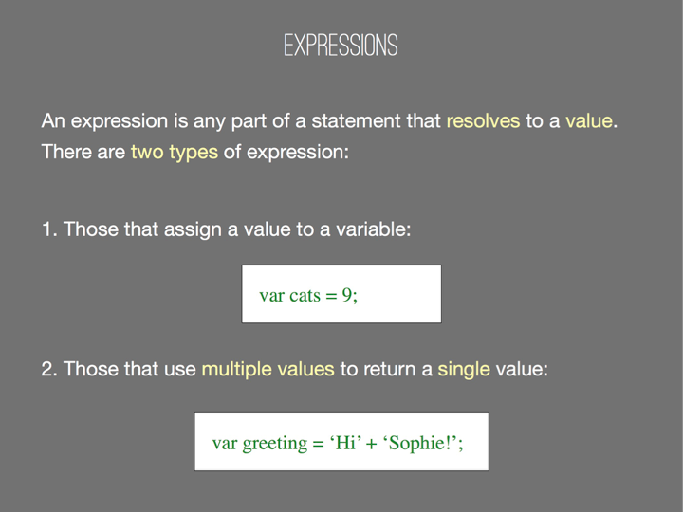
Notes:
Variables can also store the result of any "expression":
var x = 2 + 2;
var y = x * 3;
var name = 'Claire';
var greeting = 'Hello ' + name;
var title = 'Baroness';
var formalGreeting = greeting + ', ' + title;
var numKids = 5;
var partner = 'David Beckham';
var location = 'Costa Rica';
var jobTitle = 'web developer';
var future = 'You will be a ' + jobTitle + ' in ' + location + ', and married to ' +
partner + ' ' + ' with ' + numKids + ' kids.';
console.log(future);

Slide 20
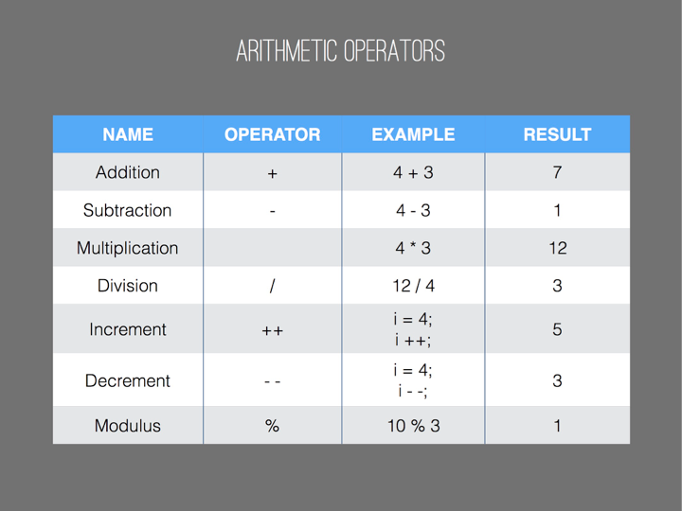

Slide 21
Concatenation
var h = “hello”;
var w = “world”;
X+W;
“hello” + “world”;
“hello ” + “world”;

Slide 22
Increment, decrement
var x = 0;
x++;
var y = ++x;
var z = x++;
x--;
x-= 5;

Slide 23
Addition vs. concatenation
var x = 1;
var y = “7”;
x+y;
typeof x + y;
y + x;
x+ +y;
x + number(y);

Slide 24
www.jslint.com

Slide 25
p5
Color, Stroke, Fill

Slide 26

By default, the color() function will take either 1 argument for grayscale or 3 arguments for rgb
var gray = color(100);
var pink = color(255,0,200);

Slide 27
We can also use conventional html color names and hex values.
var blue = color(“blue”);
var red = color(#ff0000);

Slide 28
The fil() function sets the color of the fill for all the drawable elements like shapes and lines.
fill(51);
rect(25,25,100,100);

Slide 29
Color values saved in variables can also be used as colors.
fill(pink);
rect(125,25,100,100);

Slide 30
The function noFill() turns the fill off
noFill();
rect(150,50,100,100);

Slide 31
The stroke() functions works in a similar way, but changes the stroke of the drawable element.
stroke(blue);
Triangle (50,50,50,100,100,50);

Slide 32
The noStroke() turn the stroke off (remember to turn the fill back on or you won’t see anything!);
noStroke();
fill(red);
ellipse(200,200,60,60);

Slide 33
The background() function sets the color of the canvas element and can use grayscale, rgb or html, just like stroke and fill.
var green = color(0,190,120);
background(green);
Make sure to draw your background before drawing anything else.

Slide 34
Now lets try the statements and operators we learned to change a color over time.

Slide 35
Homework
Using p5, create a design that uses variables as the arguments for the drawing functions.
Drawing functions include fill(), stroke(), rect(), line(), ellipse(), triangle() etc...
fill(0); // NOT VALID
var c = color(255,0,255); fill ( c ); // VALID
There should be at least 5 colors and 5 shapes.

Slide 36
Homework
Using JavaScript, make an HTML page with
at least 2 variables
1 arithmetic operator
1 string concatenation

